Slide 1
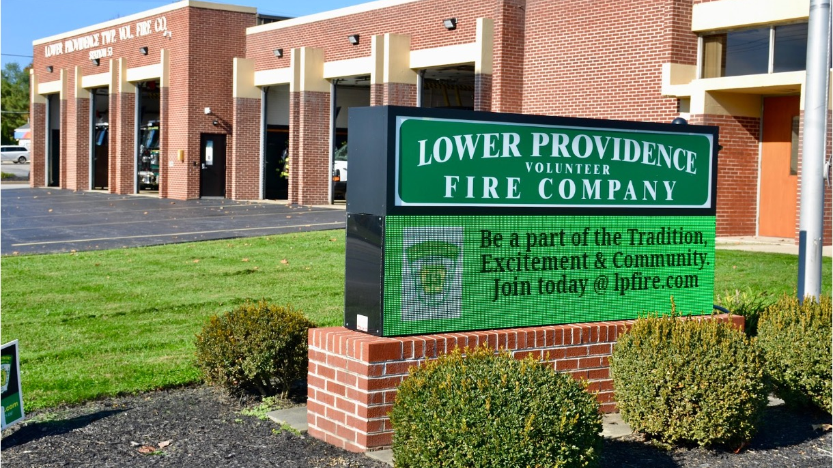

Annual Report 2023-2024
YEAR IN REVIEW
Lower Providence Fire Department I Chief@LPfire.com

Slide 2

Who We Are
James Lentz
Fire Chief
Dan Furman
President
Alex Davis
Battalion Chief

Slide 3
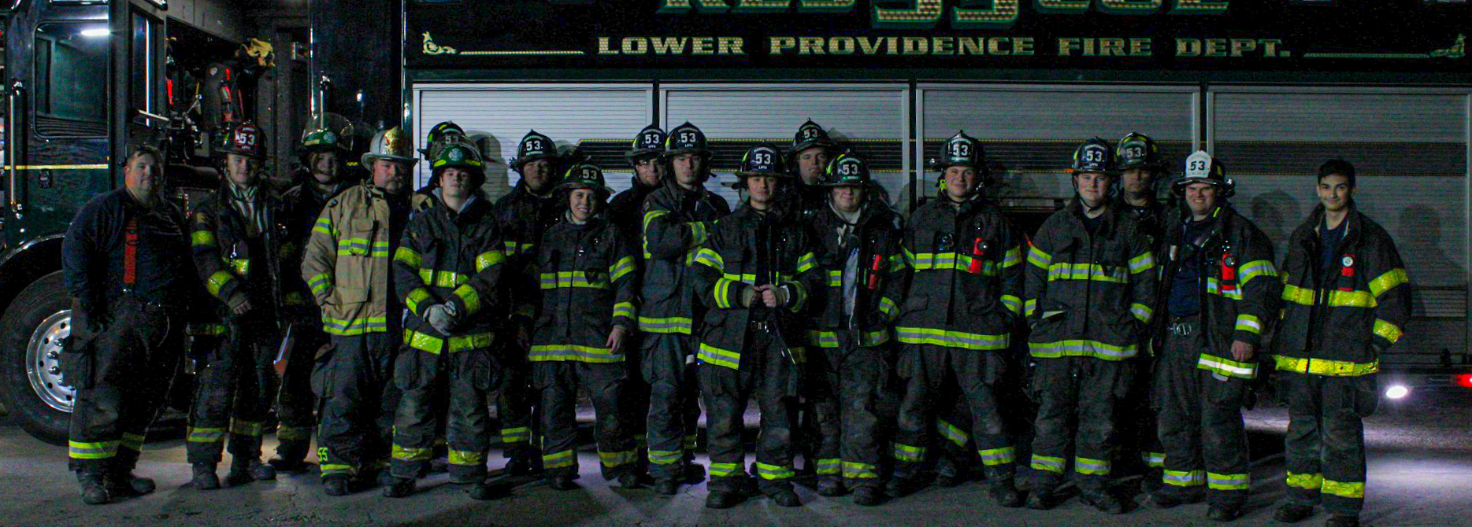

Our Mission
COURAGE | TRAINING | TEAMWORK
The mission of the Lower Providence Fire Department is to protect the life and property of the residents, businesses, and visitors of Lower Providence Township through effective and efficient fire and rescue services in conjunction with community engagement.

Slide 4




Introduction
Purpose
The purpose of this annual report is to provide a brief description of the responses the Lower Providence Fire Department responds to in the municipalities covered. The annual report will also update the organization's activity, completed projects, and points of interest over the last 2 years. We have synthesized data from the Montgomery County Department of Public Safety to provide our Community Partners with key information about LPFD.
Methodology
Emergency LPFD is compliant with the National Fire Incident Reporting System (NFIRS). Data in this section is sourced from Emergency Reporting. Emergency Reporting is the electronic NFIRS Compliant reporting systems that this agency uses to collect and transmit data. LPFD has a completed report for all emergency calls. The system includes both required and optional reporting elements and data is validated to meet National Fire Incident Reporting System (NFIRS) standards. This system captures information, response times, incident location, and outcomes.
Organization
Lower Providence Fire Department is a 100% Volunteer 501 (c) (3) non-profit organization consisting of a volunteer Board of Trustees, President, Fire Chief, and with administrative and operational officers. Funding is obtained via Fund Raising Events, Fund Drive Mailer, Billing for Service, Grant Funds, and Township contributions.

Slide 5
Financial Information
Fire House Financials at a High Level
Completed and Submitted 990 for 2022
and 2023
Fiscal and Budget Year runs July 1 through
June 30
Fiscal challenges moving forward is the increase in costs of equipment, Turn Out Gear, Apparatus and upkeep of the facilities

Slide 6
Financial Information
Act 84 Volunteer Firefighter Relief Association Financials at a High Level
Loans for Rescue and Tower- $1.3 million
Expected loan of $600,000 for new Engine expected in the spring
Received State Audit in 2024 for 2021 and 2022
Next Audit should be in 2025

Slide 7
Quick Facts
Staffing
1 Fire Chief
1 Deputy Fire Chief
1 Assistant Fire Chiefs
2 Battalion Fire Chiefs
1 Fire Captain
2 Fire Lieutenants
42 Firefighters
10 Probationary/Junior FF’s
1 Fire Police Captain
3 Fire Police Supervisors
9 Fire Police Officers
2 Fire Stations
Main Station (Eagleville)
1 Sub Station (Audubon)
Coverage Area
15.6 Square Miles
26,812 Residents (2018)
Residential, Commercial, Industrial
Industrial Park with 2.7 million sq/ft
of Buildings
Limited Access Highway
Multiple Waterways
Multiple 55 & Over Communities
Apparatus
2 Command Vehicles
2 Utility/Traffic Units
1 Field Unit
1 Heavy Rescue Unit
1 Tower Ladder Truck
3 Pumpers (Engines)

Slide 8
Fire Year Call Statistics
2023
Total Calls - 673
Fire Calls - 622
Fire Police Calls - 27
Fire Officer Calls - 24
Mutual Aid Received - 57
Mutual Aid Provided - 120
$68,304,182 Property at Risk
$3,110,100 Property Loss
Firefighter Injuries - 1
LPFD Personnel Completed 2,465.5 Hours
of Training.
LPFD Personnel Were in Service for 2636.42 Hours.
Average Turnout per Incident - 8.5 Personnel
2024
Total Calls - 770
Fire Calls - 711
Fire Police Calls - 31
Fire Officer Calls – 27
Special Service - 1
Mutual Aid Received - 52
Mutual Aid Provided - 132
$74,413,950 Property at Risk
$1,264,050 Property Loss
Firefighter Injuries - 1
Completed 3024 Hours of Training.
LPFD Personnel Were in Service for 2234 Hours.
Average Turnout per Incident - 8.3 Personnel

Slide 9
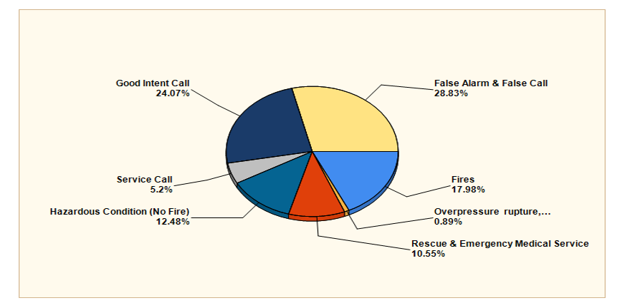
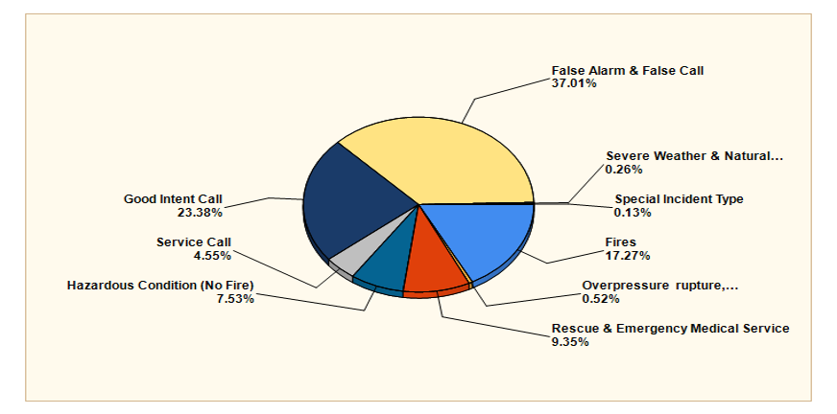
Incident Types
2023 Breakdown
2024 Breakdown

Slide 10
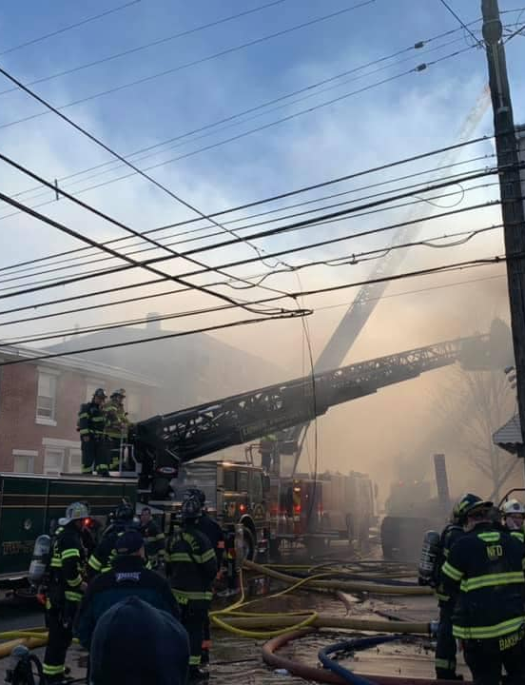
Mutual Aid Provided
2023
Bridgeport - 1
Collegeville - 8
Conshohocken - 1
East Norriton - 11
Norristown - 27
Perkiomen - 3
Phoenixville - 1
Skippack - 4
Upper Merion - 4
Upper Providence - 27
West Norriton - 20
Worcester - 13
2024
Bridgeport - 1
Collegeville - 11
Conshohocken - 1
East Norriton – 9
Honeybrook – 1
Montgomery – 2
Norristown - 34
Perkiomen – 3
Philadelphia - 1
Phoenixville – 1
Schuylkill - 1
Skippack - 1
Upper Gwynedd - 3
Upper Merion - 8
Upper
Providence - 21
West Norriton – 30
Whitemarsh - 1
Whitpain - 1
Worcester - 7

Slide 11
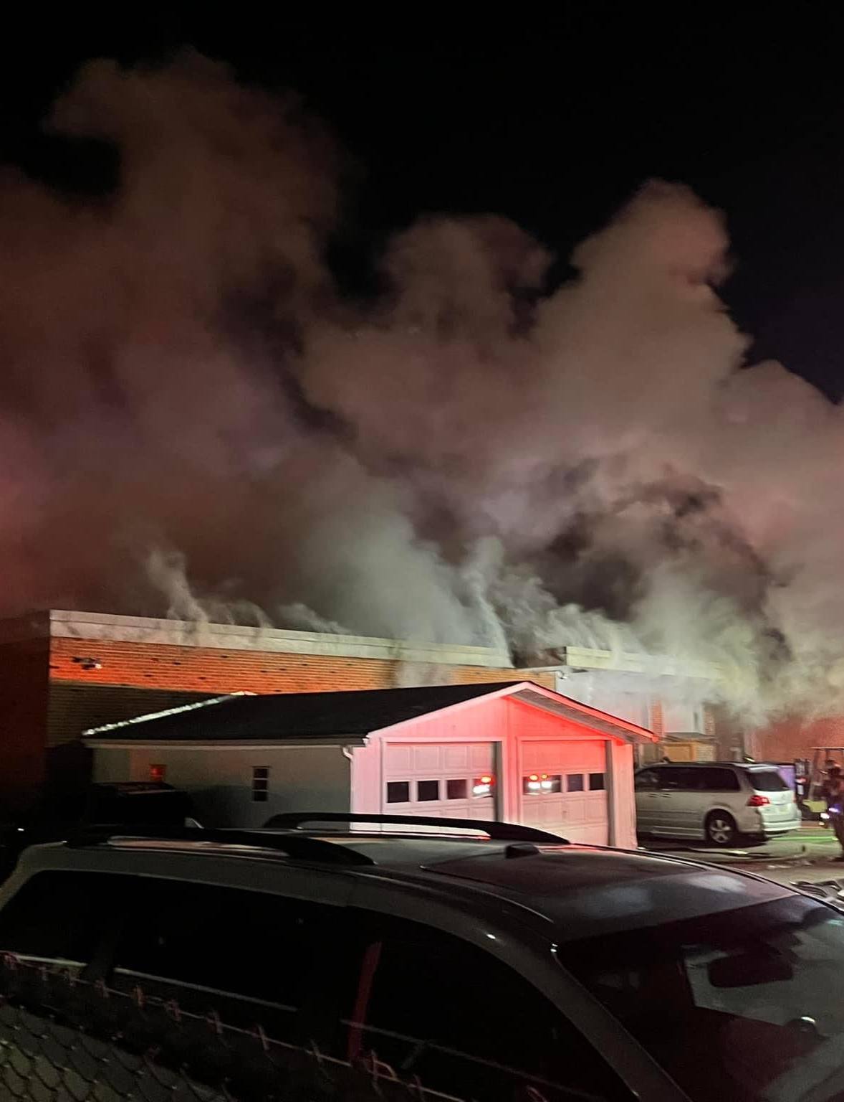
Mutual Aid Received 2023
Berwyn Fire
Company – 1
Bridgeport Fire Department - 2
Collegeville Fire Company - 11
Conshohocken Fire Department - 1
Norriton Fire
Company - 3
Harmonville Fire Company - 2
Kimberton Fire Company - 1
Limerick Fire Department - 3
Montgomery County Special Operations - 1
Norristown Fire Department - 8
Perkiomen Fire Company - 4
Phoenixville Fire Department - 5
Plymouth Fire
Company - 1
Royersford Fire Department - 2
Valley Forge Fire Company - 6
Skippack Fire
Company - 3
Towamencin Fire Company -1
Upper Gwynedd Fire Department -1
Upper Merion Fire Department - 11
Upper Providence Fire Department - 25
Jefferson Fire
Company - 20
Worcester Fire Company - 12

Slide 12
Mutual Aid Received 2024
Bridgeport Fire Department - 2
Collegeville Fire Company - 27
Norriton Fire Company - 5
Harmonville Fire Company - 2
Montgomery County Special Operations - 1
Norristown Fire Department - 9
Perkiomen Fire Company - 8
Phoenixville Fire Department - 1
Skippack Fire Company - 6
Upper Merion Fire Department - 3
Upper Providence Fire
Department - 29
Jefferson Fire Company - 18
Worcester Fire Company - 5
Thank you to the Lower Providence EMS and Lower Providence Police for the continued support on a daily basis.

Slide 13
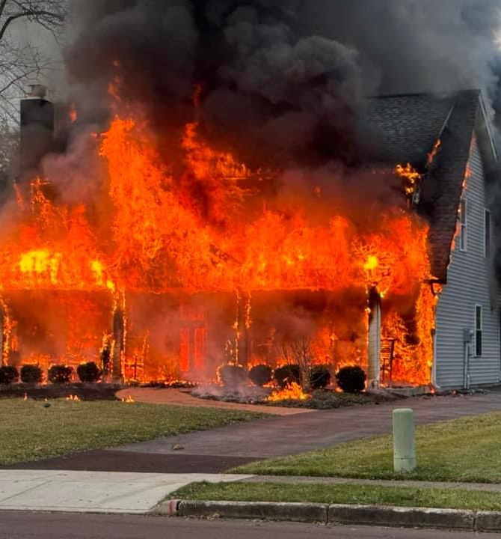
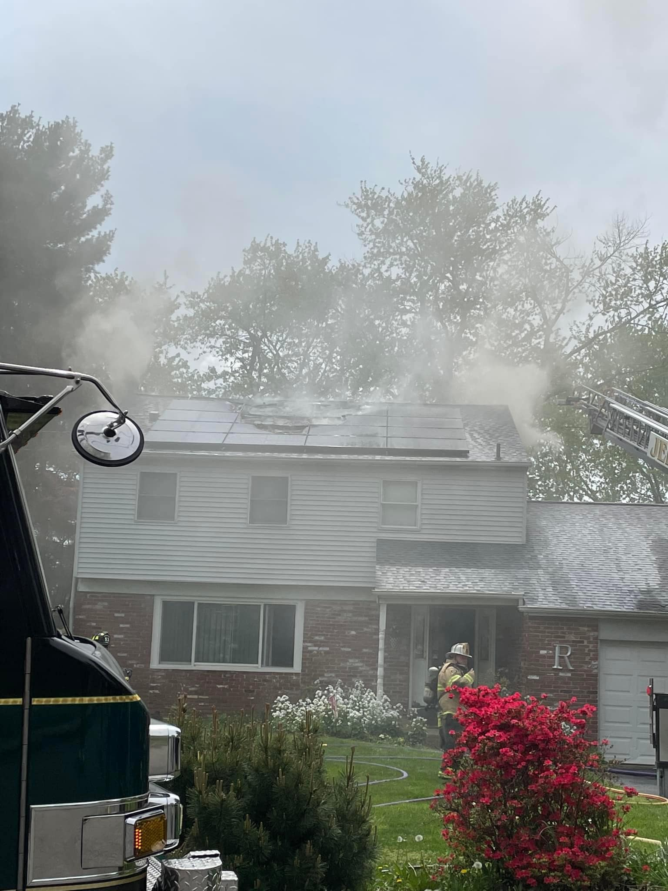
2023 Remarkable Incidents
925 South Trooper Rd - Commercial Building Fire
1429 Pawlings Road - House Fire
2920 Martha Lane - House Fire
537 Lexington Lane - House Fire
713 Barrington Road - House Fire

Slide 14
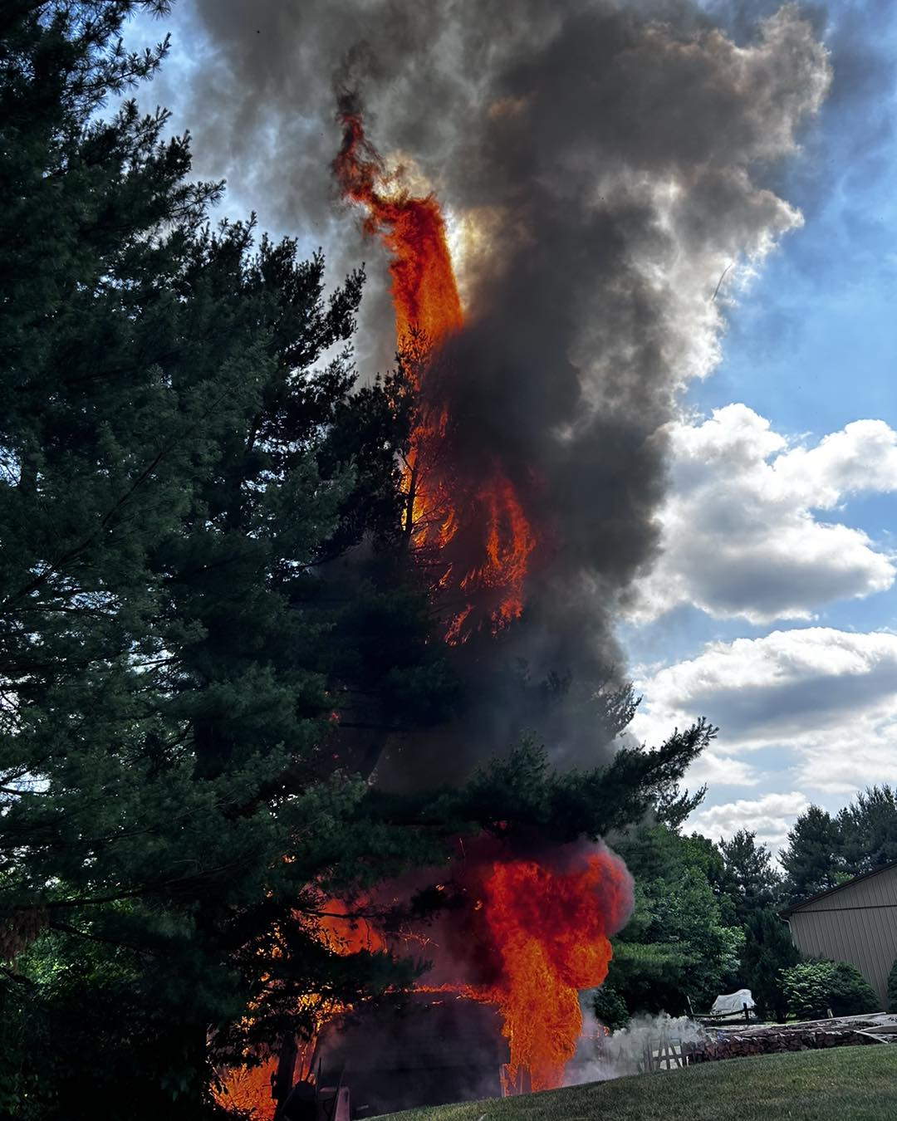
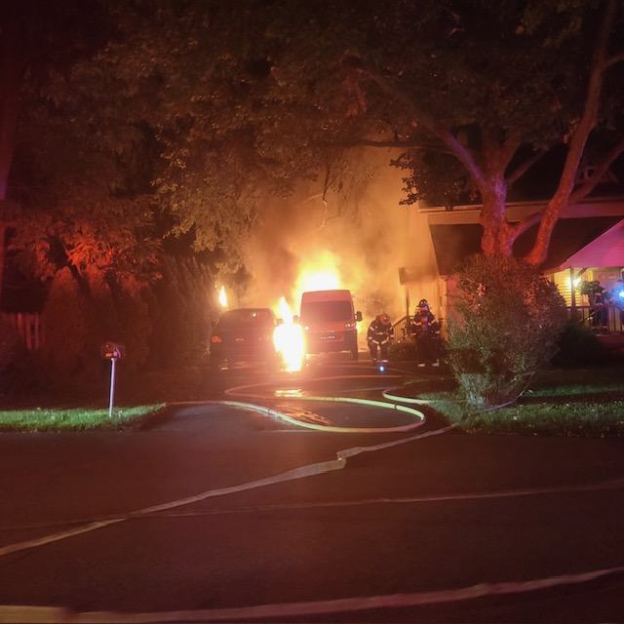
2024 Remarkable Incidents
208 Lauman Avenue - House Fire
3852 Nancy Lane - Propane Tank (Explosion)
45 South Park Avenue - House Fire
2874 Ridge Pike - Commercial Building
5006 Edward Lane - House Fire (Garage)

Slide 15
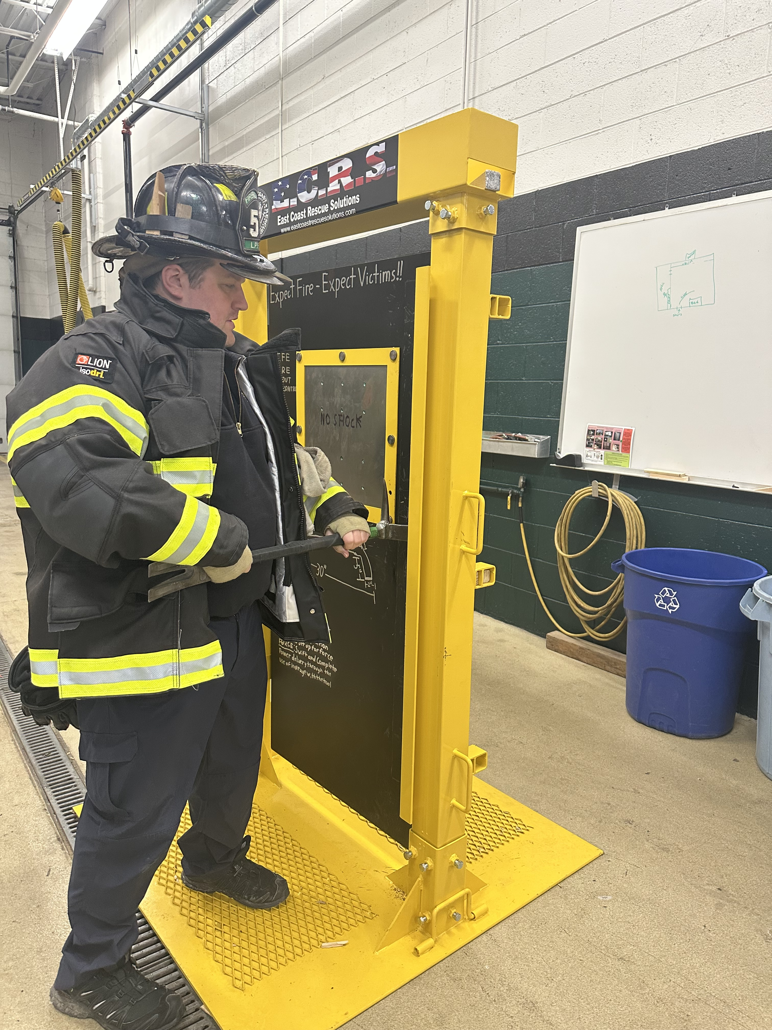
Accomplishments
Reformatted our recruitment program in partnership with Worcester Fire Company
Implemented Member Retention Team
Acquired a forcible entry training prop
Completed an additional internal audit and reorganization of training records
Obtained Self-contained breathing apparatus fit test machine (State Grant facilitated by Representative
Joe Webster's Office)
Completed implementing the updated fire response procedures (Alarm Boxes) for Lower Providence Township to comply with the locally and regionally adopted response procedures to include 5 Engine Companies and 2 Ladder Companies on every reported building fire.
The Engine ordered in November 2022 is on track for delivery in Spring 2025. The final 2022 price is $785,370 ordered today would be $1.21M (2017 cost $517,000).

Slide 16
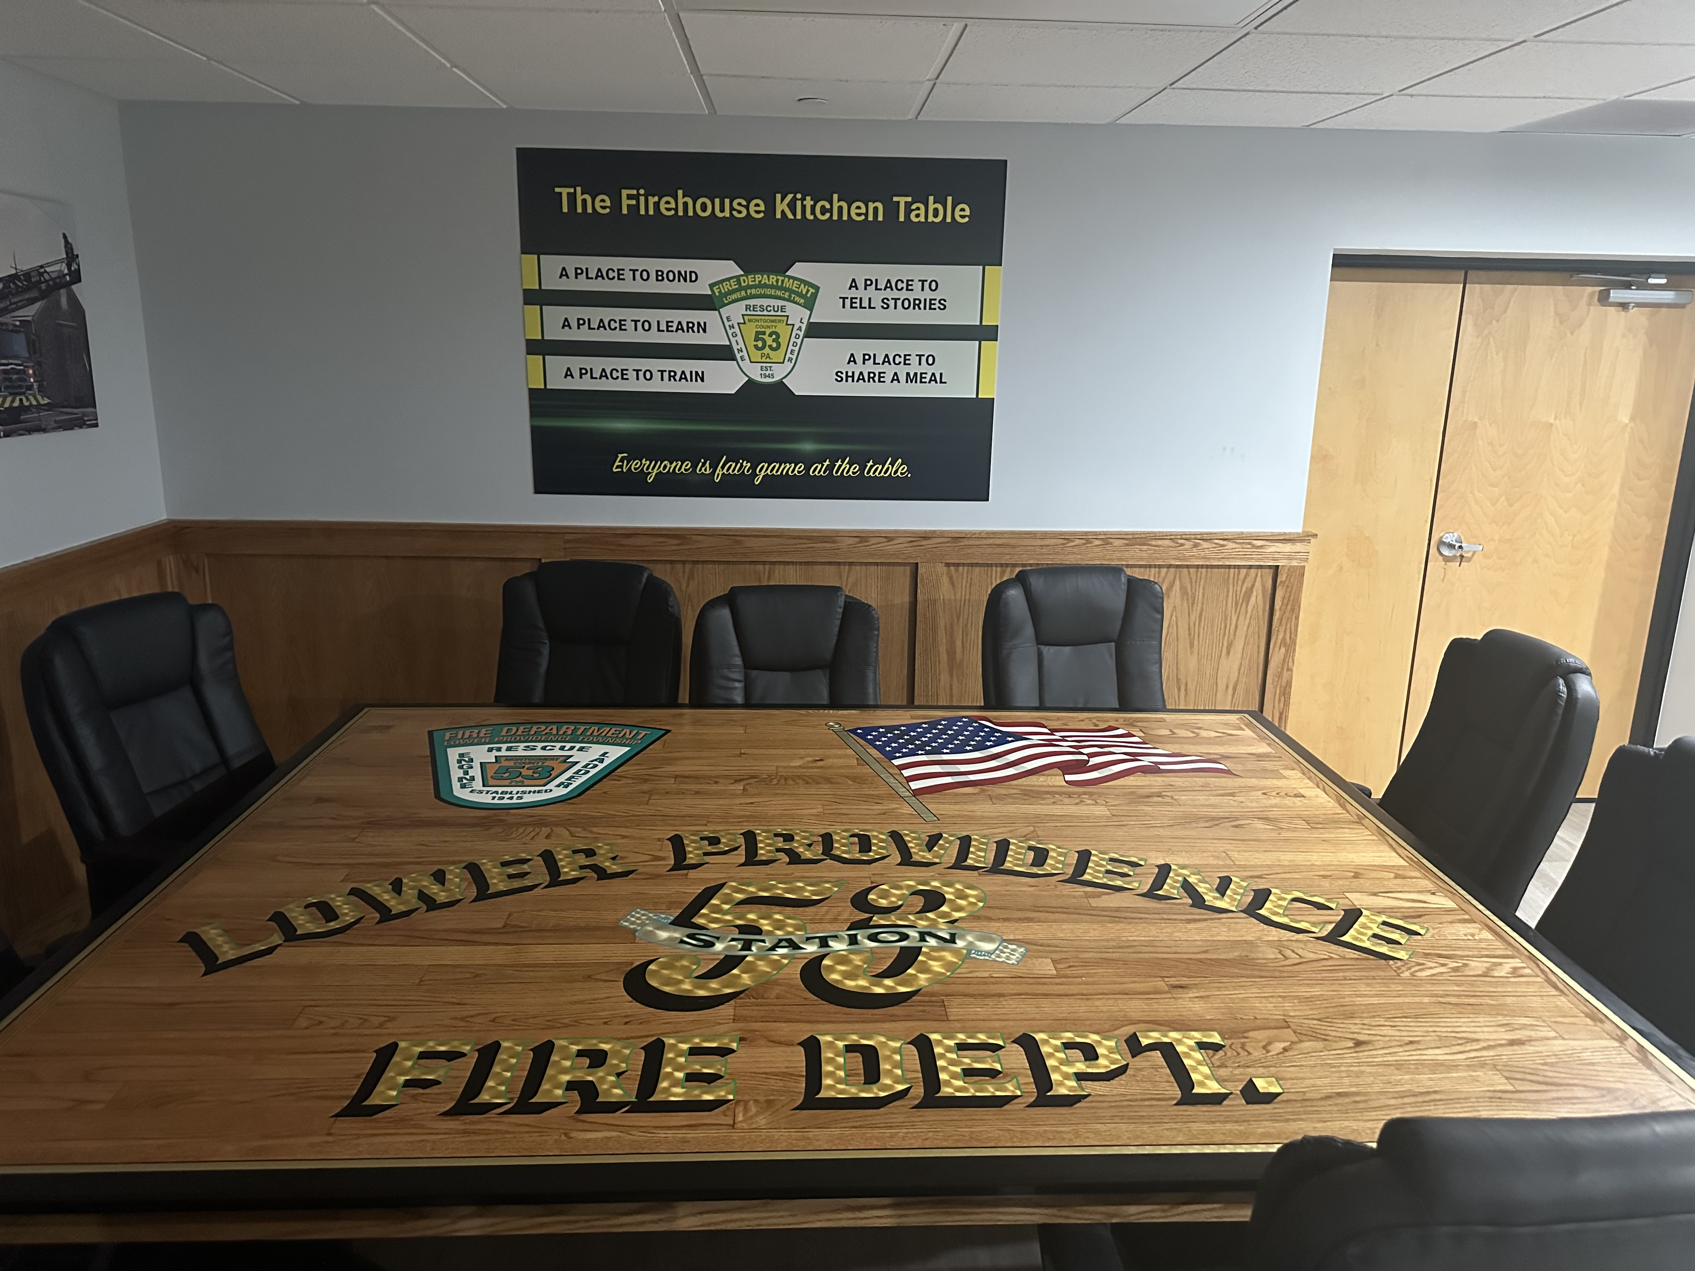
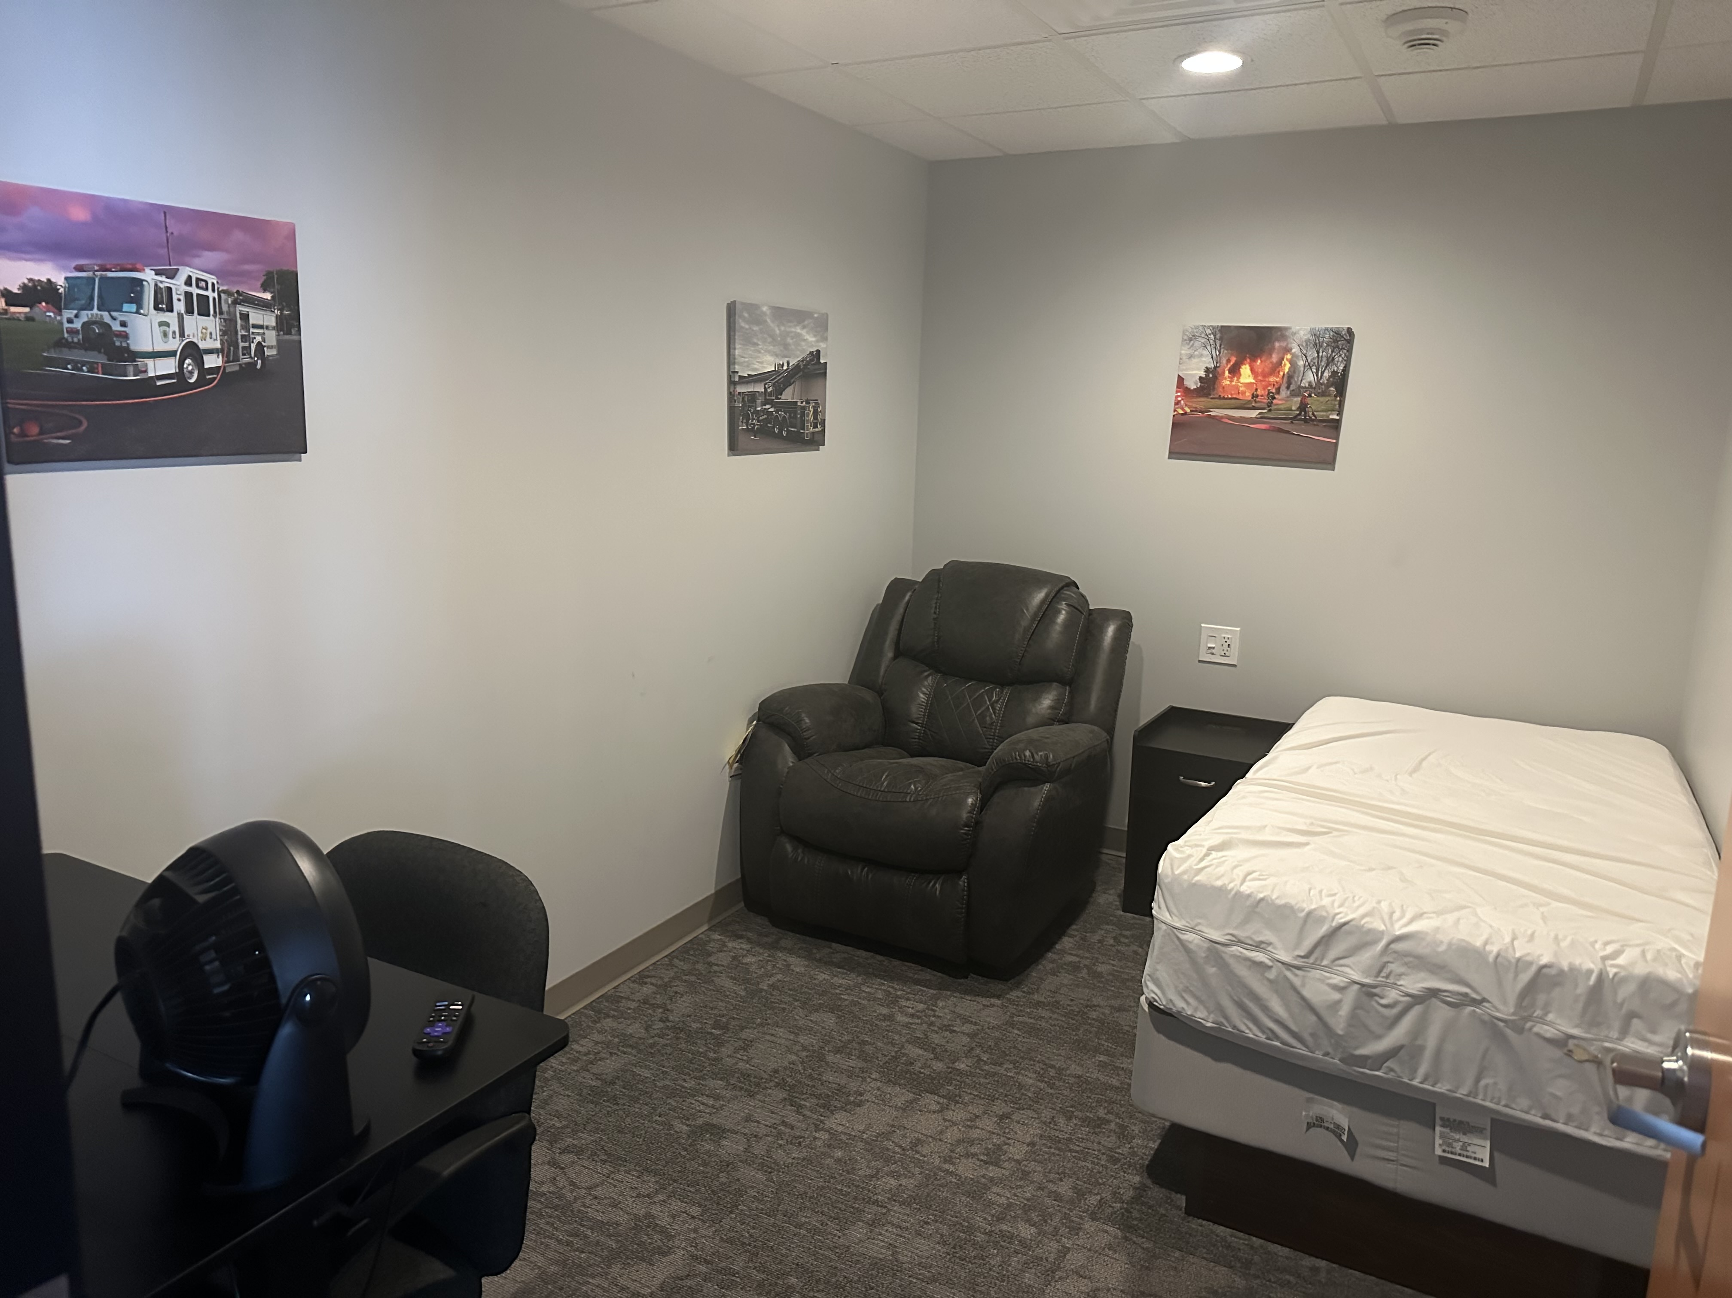
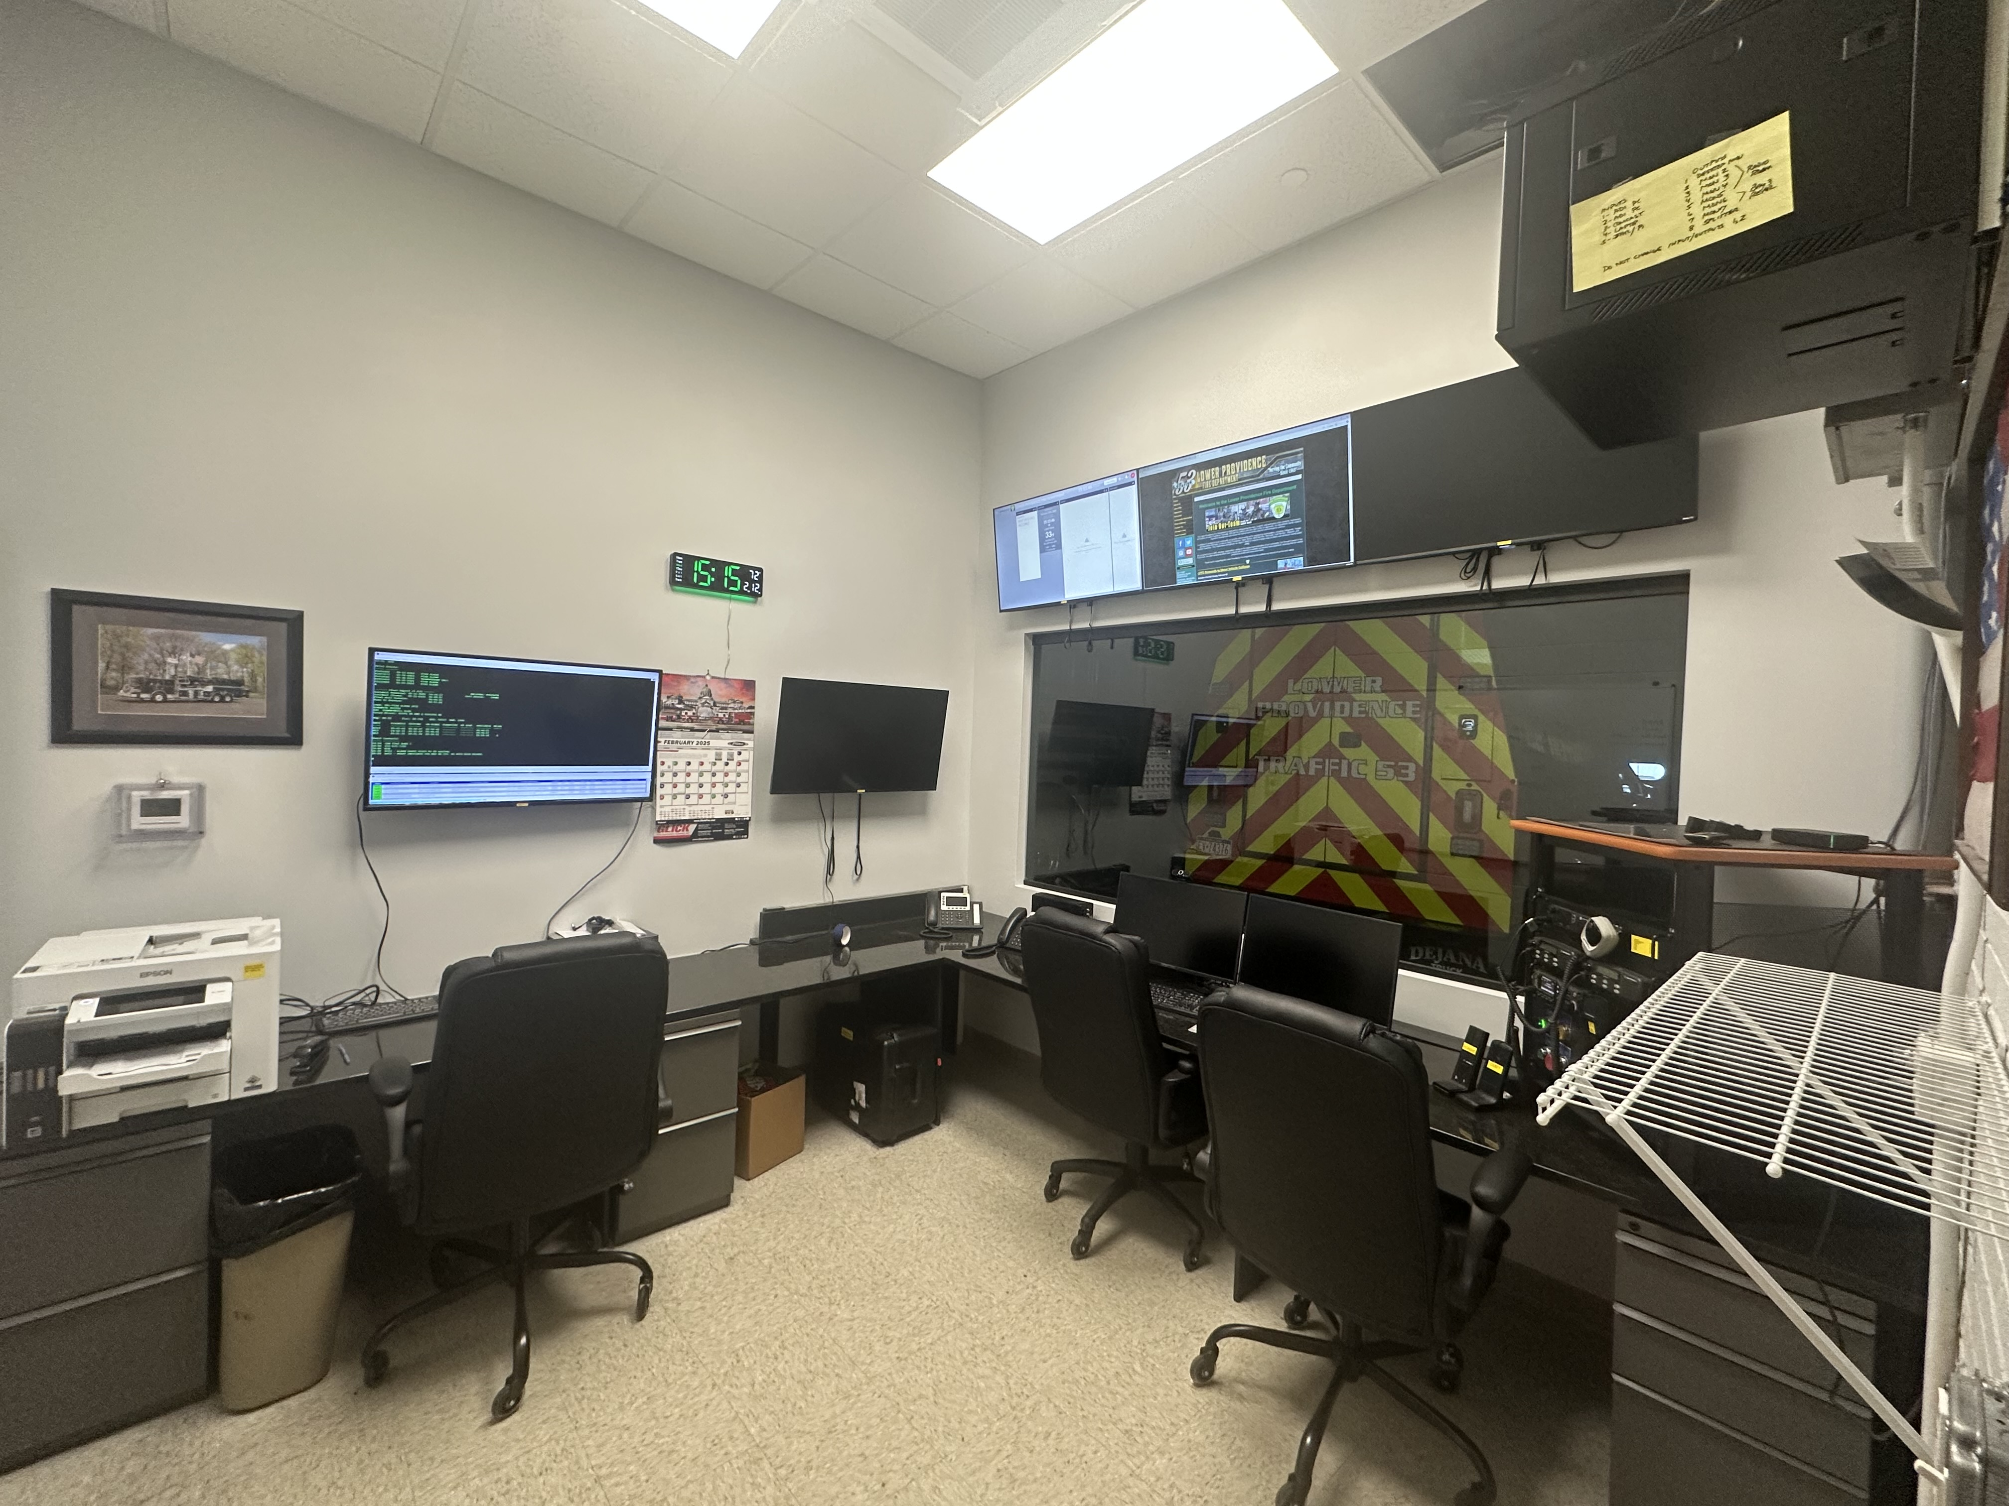
Accomplishments
Completed Firehouse renovations
Acquired new Utility Vehicle - 2024 Chevrolet Silverado 2500HD - State Grant facilitated by Representative Joe Webster's Office
Acquired new Traffic Unit 2023 Chevrolet
Silverado 3500 HD
Acquired a forcible entry training prop
Received Assistance to Firefighter Grant
for $280,000 for new SCBA
Create and adopted additional Regional Operating Procedures

Slide 17
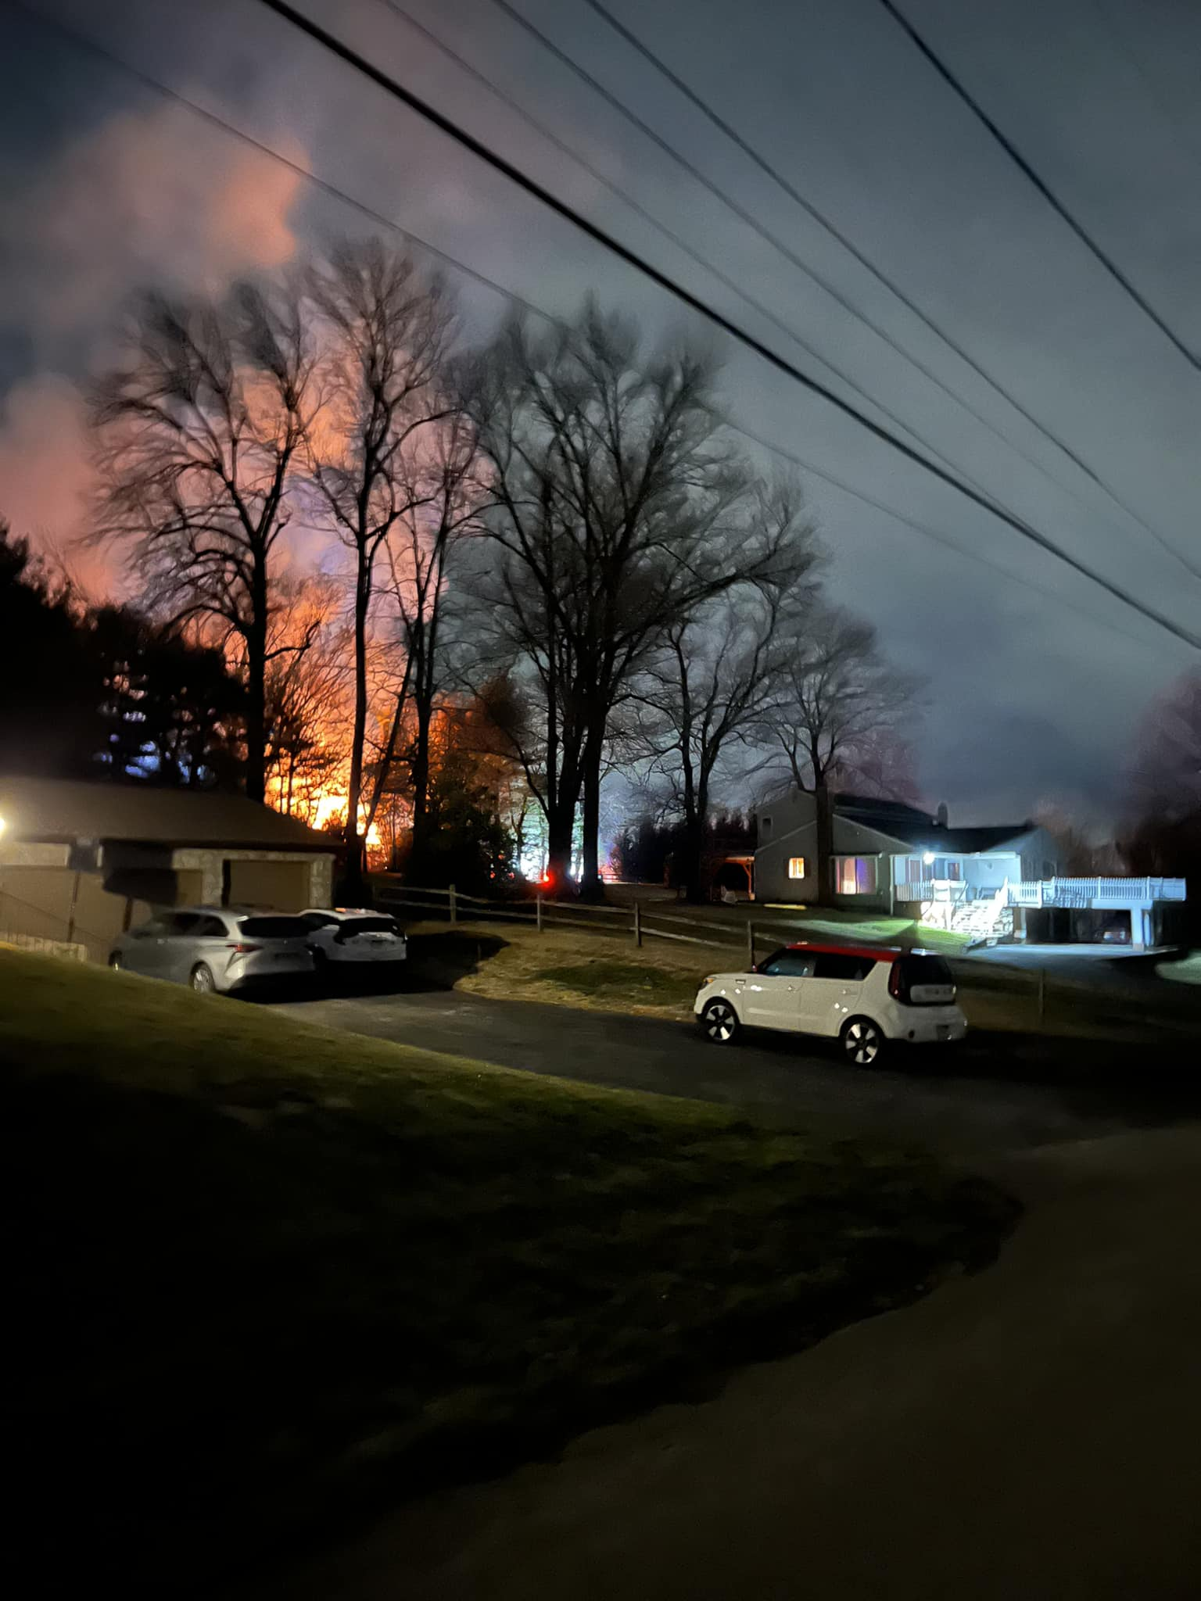
Regional Operations Committee Highlights
Made up of Fire Companies and/or Fire Departments
representing the following 9 municipalities incorporating
4 municipal fire departments and 22 volunteer fire companies.
Lower Providence Township, Norristown Borough,
Upper Merion Township, East Norriton Township, West Norriton (2024)
Bridgeport Borough, Plymouth Township, Conshohocken Borough and
Lower Merion Township
Revised the existing Low Rise Structure Fire Response Policy
Created Incident Command Aid Policy
Created Tanker Operations Guide
Created Fireground Communication Guideline
Created Regional MAYDAY Guideline

Slide 18
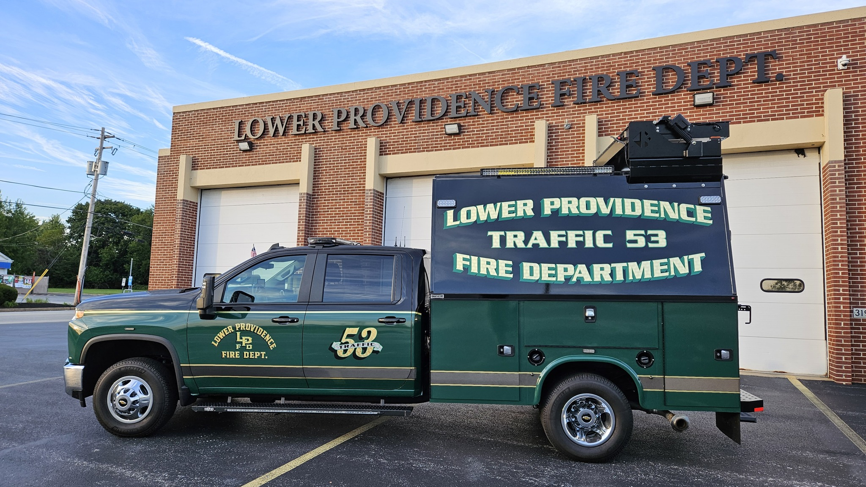
New Apparatus - Traffic 53
2023 Chevrolet Silverado 3500HD $112,927 Cost

Slide 19
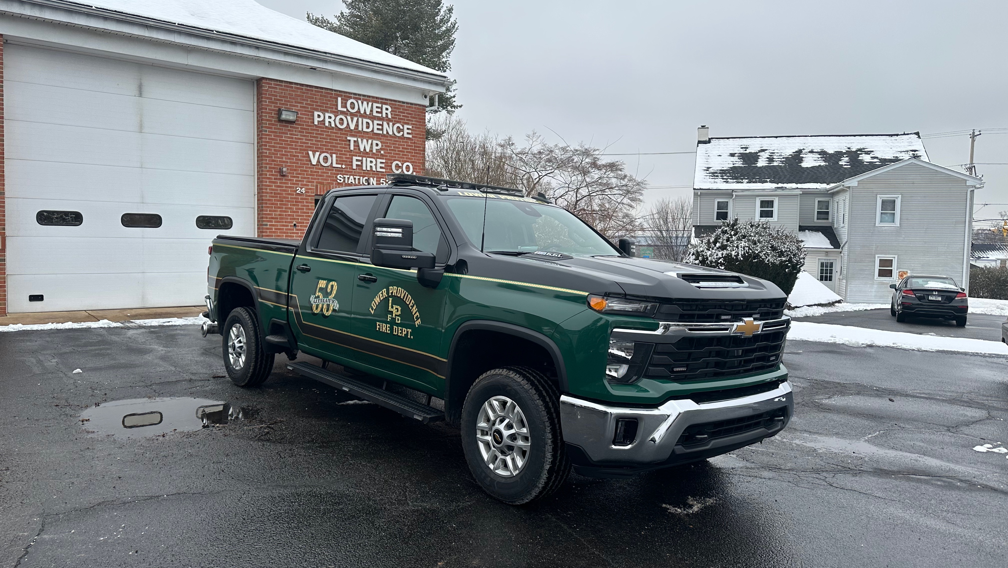
New Apparatus - Utility 53
2025 Chevrolet 2500 Silverado, $100,000 Grant
Grant was facilitated through State Representative Joe Webster's Office

Slide 20
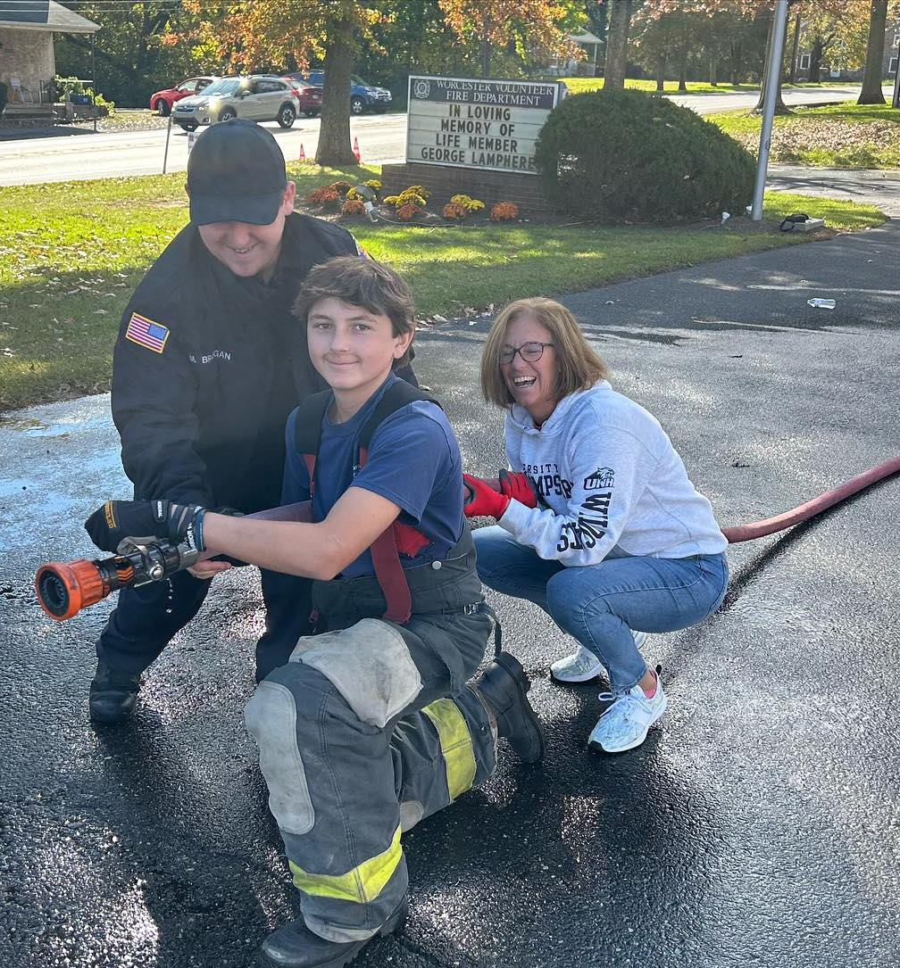
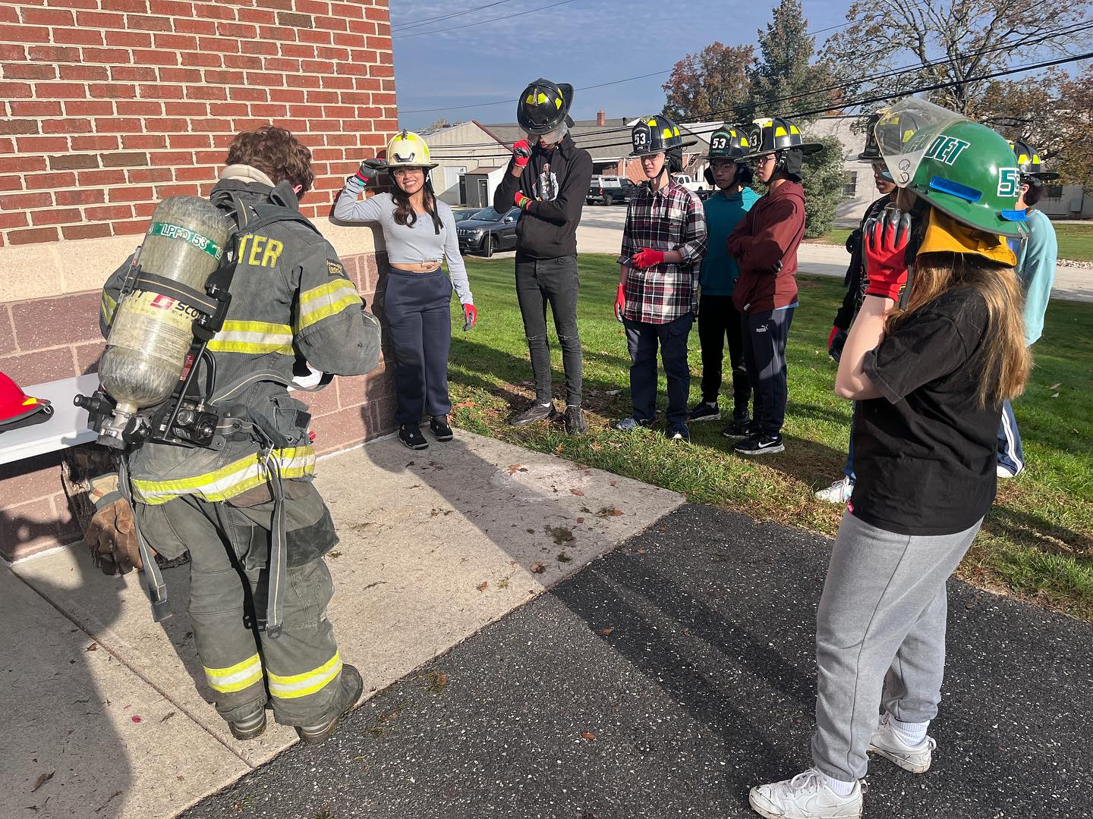
Recruitment
Brought in 47 new members
33 Firefighter Candidates
6 Fire Police Candidates
8 Contributing (Administrative)
Of those a Total of 32 new members have been retained
Recruitment Activities
9th Grade Career Expo (2) 2023/2024
Methacton High School Career Day (4)
Methacton High School Recruitment Assembly 2023
Recruitment Day’s at the fire stations (3) 2023/2024
Arcola Middle School STEAM Day (2024)

Slide 21
Active Roster

Slide 22
Committed Staffing – History
1945 - 2020
Spring 2021
Summer2022
Legacy Response Model
Development of Committed Staffing Model and Implementation Plan
Lower Providence Township Support and Funding
Station 53A Renovation Funding Sought
Station 53A Renovations Completed
Department Decision to Pursue Improved Staffing Model
October 2020
January 2022
October 2024
Driving Forces
Decline in volunteerism in conflict with increasing demands on our Fire Department
Moral obligation to the residents and visitors of Lower Providence Township and surrounding communities
Desire to be a progressive regional leader
Reliance on regional mutual aid and a desire to deliver on our obligations to the system
Strategy
Establish a plan for change that the organization and membership could withstand
Implement a committed come-from-home model to shore up concerns about adequate personnel response.
With adequate response covered, turn attention to reducing response times
Improve Fire Station 53A to support around-the-clock staffing
Offer flexible in-station staffing programs but mature them over time to meet organizational needs
Recruit firefighters who value being in the fire station and responding to emergencies quickly while still offering a valuable role to those who cannot give in-station time on a regular basis
Notes:
57% increase in responses since 2025
Top 3 busiest all volunteer firehouses in the county
Tops in terms for fire duty

Slide 23
Committed Staffing – Return on Investment
Staffing Program Overview
Staffed Duty Chief position ensures qualified leadership to keep our community and firefighters safe.
In Station Staffing (ISS) provides adequate and timely response to emergencies in and around Lower Providence Township
Come From Home (CFH) staffing provides adequate response when there is no in-station crew, responds with the second apparatus, or covers the in-station crew at the firehouse when they are on another emergency
The targets for in-station staffing response time are 60 seconds between 6AM and 10PM and 120 seconds between 10PM and 6AM.
Staffing program does not cover weekdays 6AM-6PM as we rely on staff augmentation from Lower Providence Township staff.
What is Next?
Continued cultural evolution towards the
ISS-first model
Recruitment of additional qualified firefighters to join our ranks
Seek to provide staffing coverage for 100% of staffing periods and further reduce emergency response times.
Progress to Date
Firehouse renovations completed
Policies and procedures established
Cultural evolution towards adequately staffed and rapid responses
LPFD has reduced Engine 53 response time by 2:10 (42%) Since Q1 2023
Response Time is average response time for the period shown including periods that are not covered by our staffing programs

Slide 24
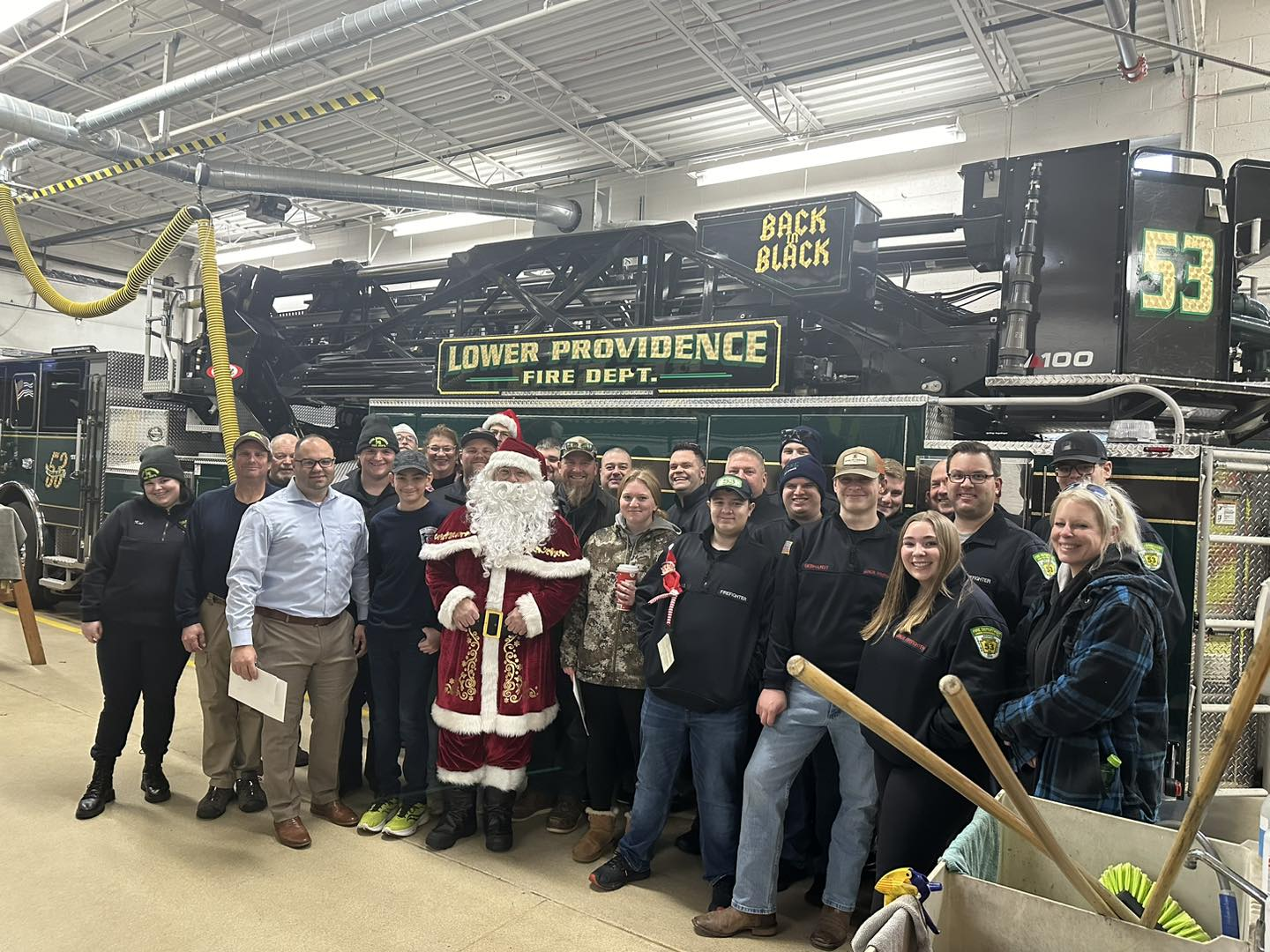
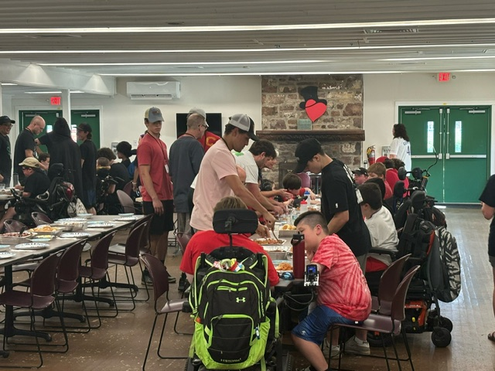
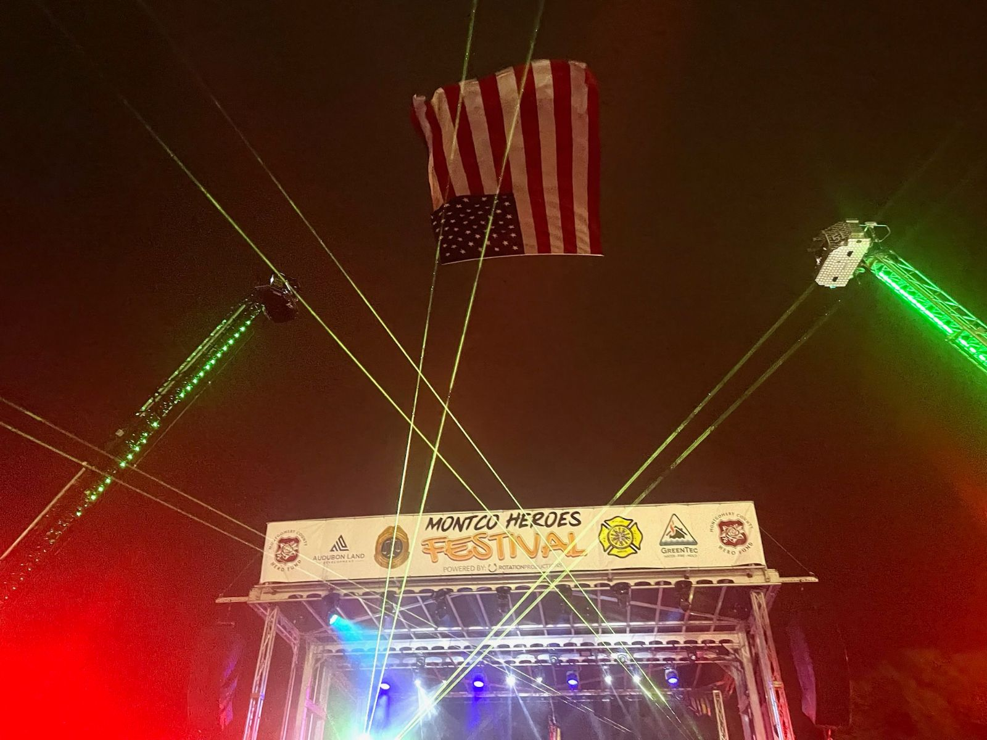
Giving Back
Annual Santa visit in December of each year.
On Sunday, August 4th, 17 members of the LPFD had the privilege of preparing and serving dinner to 80 campers and their counselors at the annual MDA week-long camp. This was the first time the LPFD had the privilege to participate in this event. Next Event - Sunday August 10, 2025
On September 30, 2023, 2nd Annual
Montgomery County Heroes Festival.
On September 28, 2024, 3rd Annual
Montgomery County Heroes Festival.
Coming Soon... May 17, 2025 4th Annual Montgomery County Heroes Festival.

Slide 25
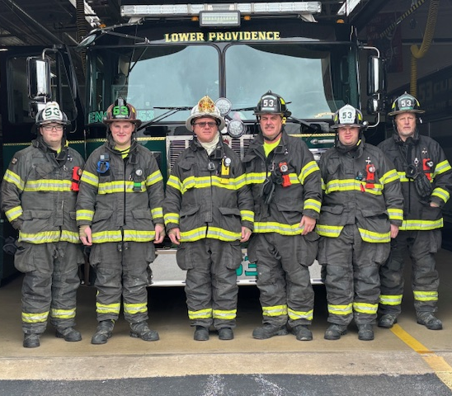
Legislative Priorities
Local
Develop progressive fire codes that address fire safety concerns with the storage and charging of Electric Vehicles.
Implement a fire/life safety inspection program that incorporates the non-profit facilities in the township.

Slide 26





Legislative Priorities
Commonwealth of Pennsylvania
Increase funds into the Act 104 Municipal Fire Grant
Connecting FFs with Preventative Physicals and Mental Health Care
Carbon Monoxide Alarms in childcare facilities

Slide 27
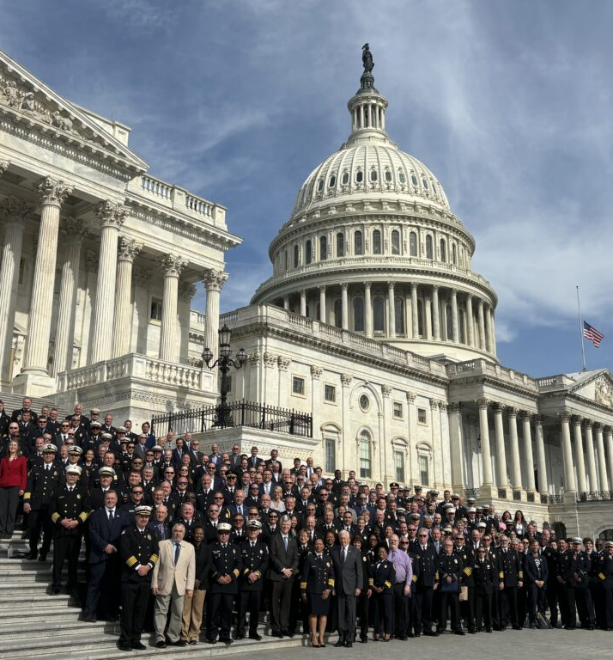
Legislative Priorities
Federal Grants
Maintain……..
Assistance to Firefighters Grant program (AFG)
Staffing for Adequate Fire & Emergency Response (SAFER)

Slide 28
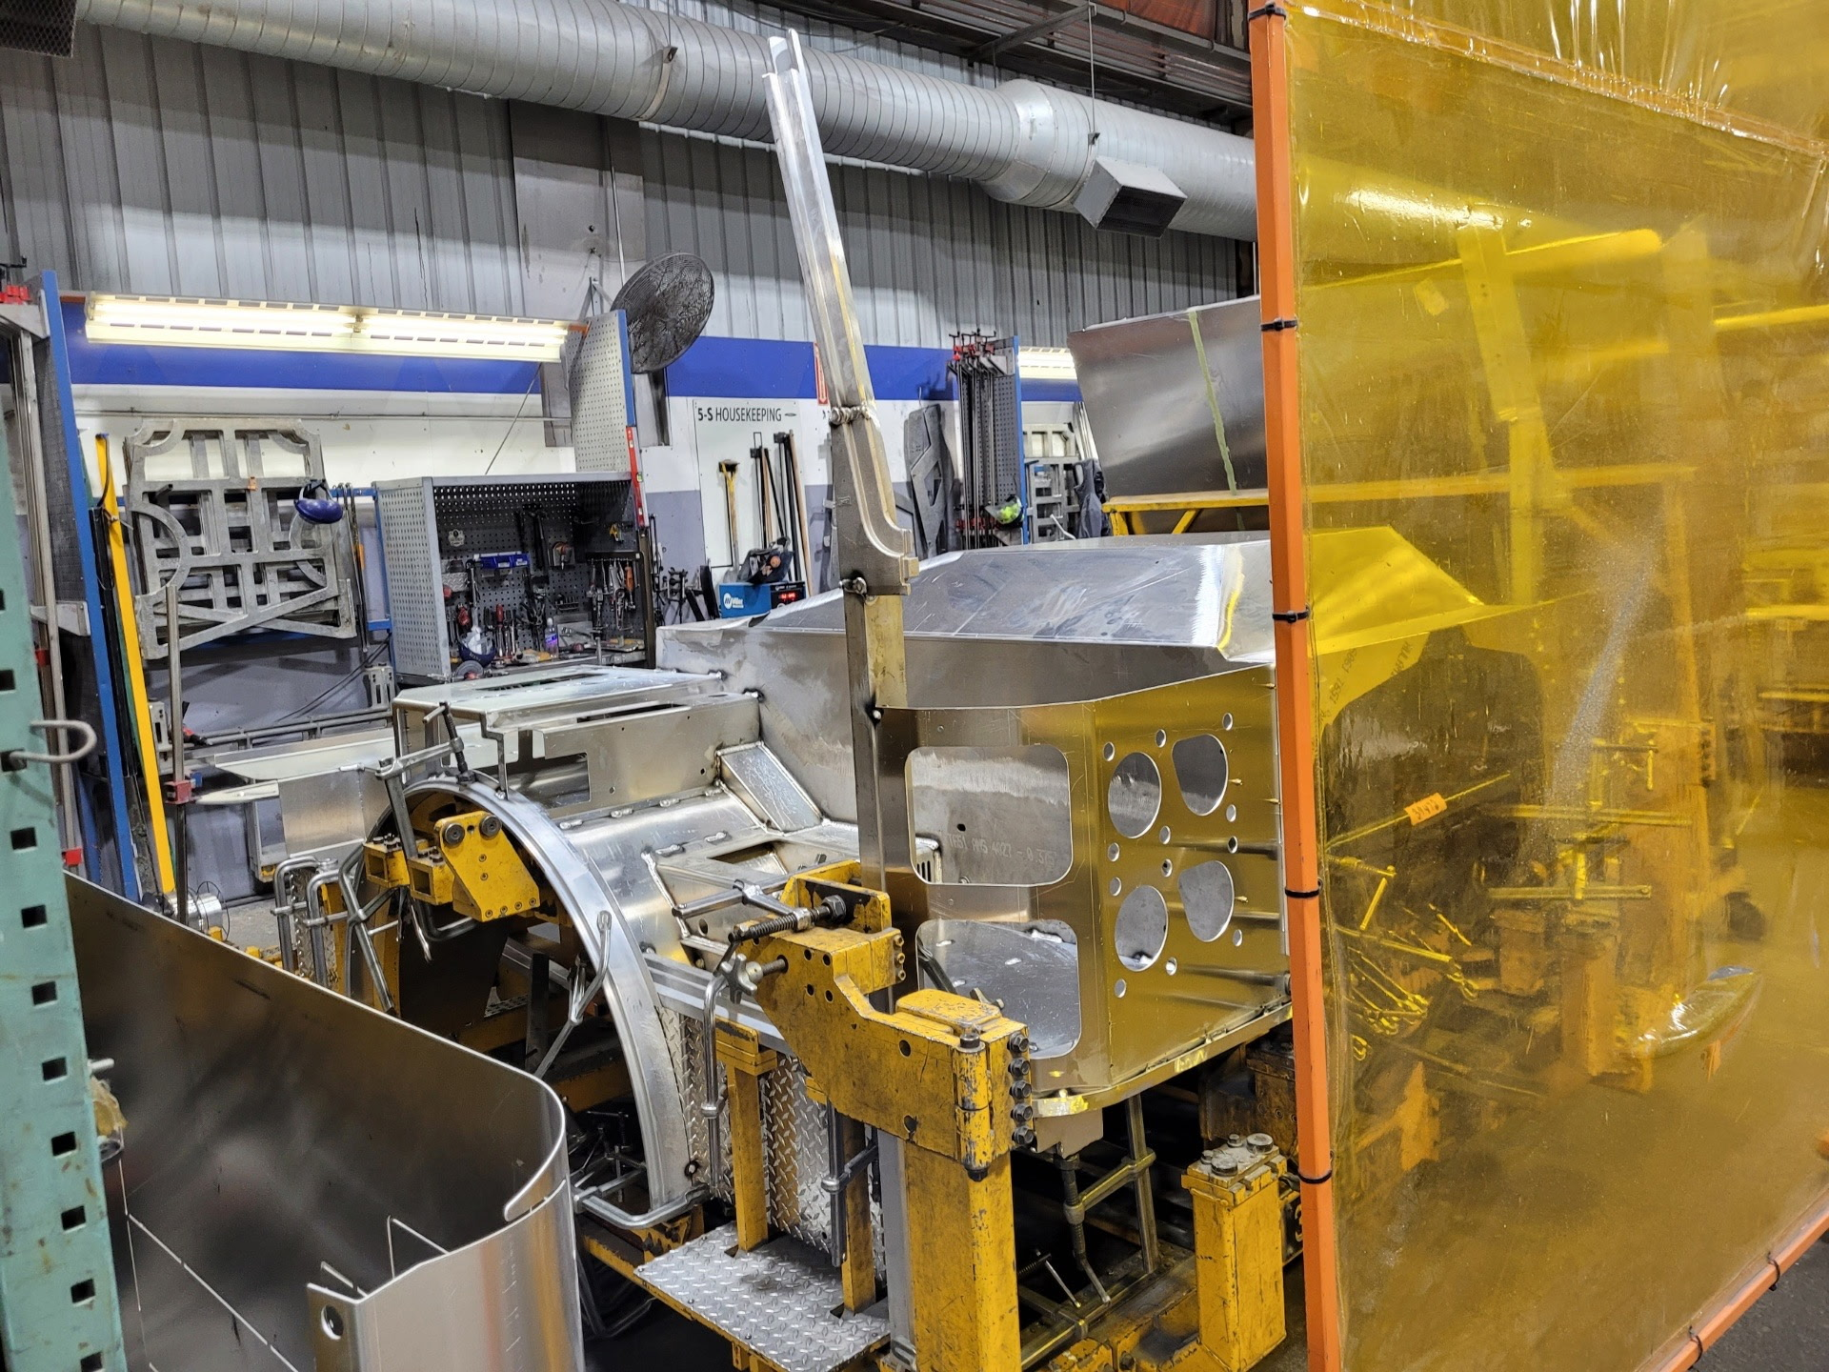
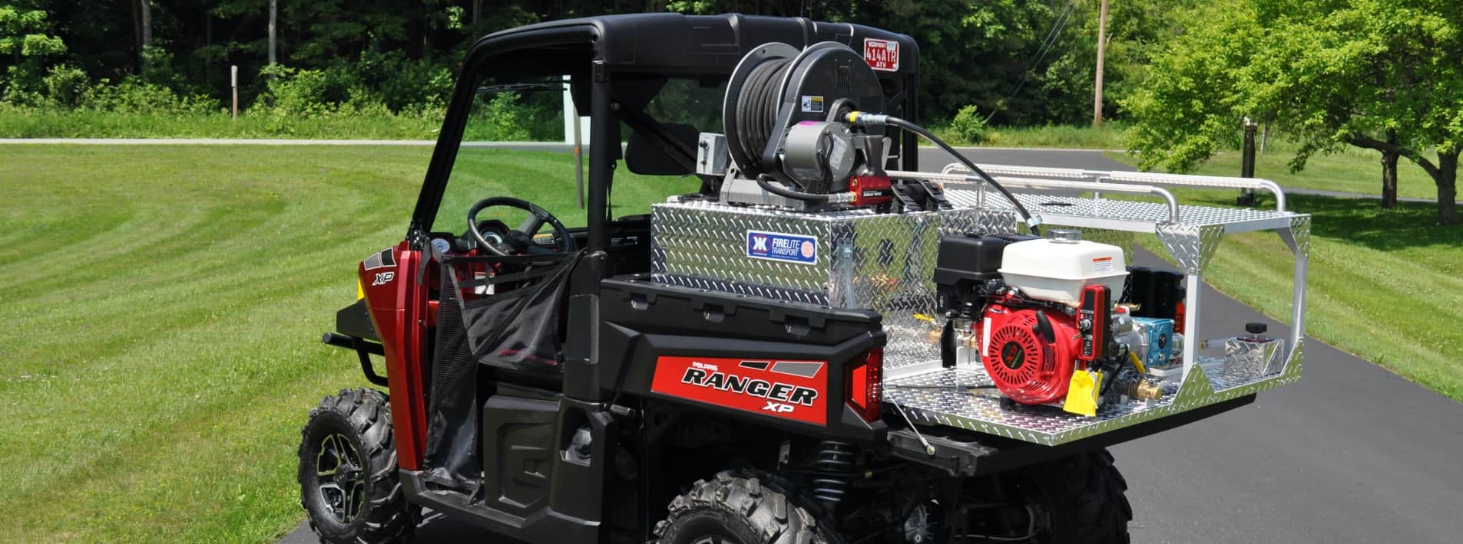
Looking Forward…
Arrival of 2025 Pierce 1500 GPM Pumper
UTV/Trailer *
Breathing Air Compressor/SCBA Fill Station*
Concept plan for the Audubon Emergency Services Substation
Acquisition of federal mandated NERIS compliant software (National Emergency Response Information System)
* Thank you to Representative Joe Webster & Staff for facilitating this grant of $150,000 through the American Rescue Plan Act

Slide 29
Lower Providence Leadership Team
Thank You!
Operational Officers
James Lentz, Fire Chief (Trustee)
Christopher Reynolds, Deputy Chief
James Alexander, Assistant Chief
Alexander Davis, Battalion Chief
William Murphy, Battalion Chief
Chad Davis, Fire Captain
Zach Griffiths, Lieutenant
Charles Miller, Jr, Lieutenant
Mark Yakscoe, Chief Engineer
Bruce Errington, Engineer
John Evans, Engineer
Andrew Getka, Health & Safety
Nick Cherniak, Fire Police Captain
Keith Meserole, Fire Police Lieutenant
Lou Ruh, Fire Police Sergeant
Mark Fireoved, Fire Police Corporal
Administrative Officers
Dan Furman, President (Trustee)
William Murphy, Vice President
Carol Hoy, Secretary
Keith Meserole, Treasurer
Lou Ruh, Financial Secretary
Jackie Rittenhouse, Trustee Chair
David Cemini, Trustee
Fran Getka, Trustee
Mark Bogle, Trustee
Mark Fireoved, Trustee

Slide 30

JOIN TODAY!
Looking for Entry-Level Firefighters
Incentives
Modern Facility w/ private bunk rooms
Pay Per Call Stipend
Come from Home Stipend
In station Staffing Stipend
Meal Stipends
Uniforms Provided
Up to 100% County Property Tax Rebate
.5% Earned Income Tax Rebate From Methacton School District

Slide 31
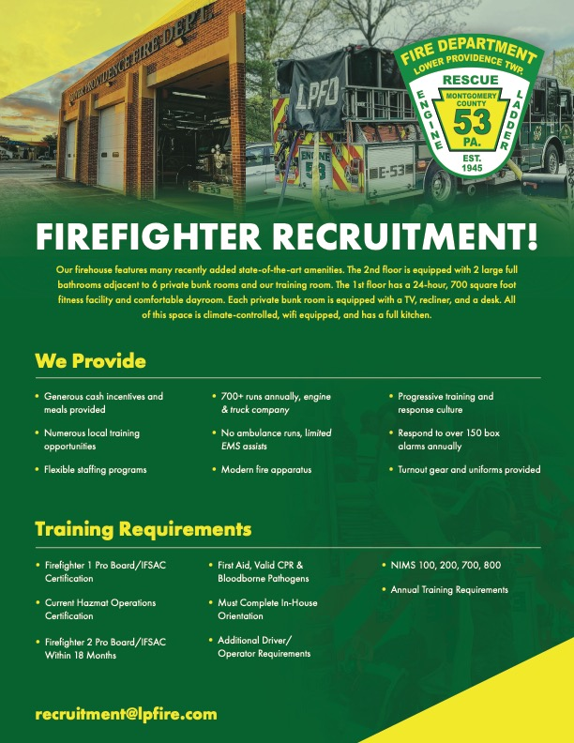
JOIN
TODAY!
Looking for Firefighters

Slide 32
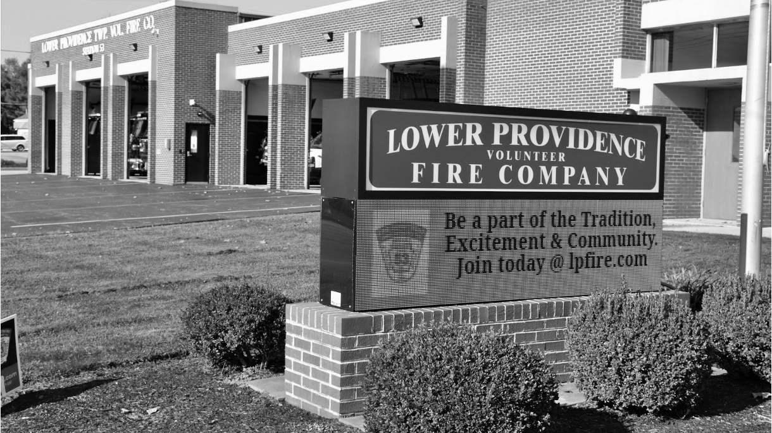

Thank You!
Questions? Comments?

